Slide 1
Agenda
Evidence
Components of meta-analysis
Pseudoscience, critical thinking
Open office hours
Presentations start NEXT WEDS!!
10-15 mins: background, data source, a couple of figures you made
DO: show that you’ve put some effort into your project; try to have a narrative
DON’T: show groundbreaking research that will solve all major societal issues
Sign-up sheet goes live 8p tonight

Slide 2
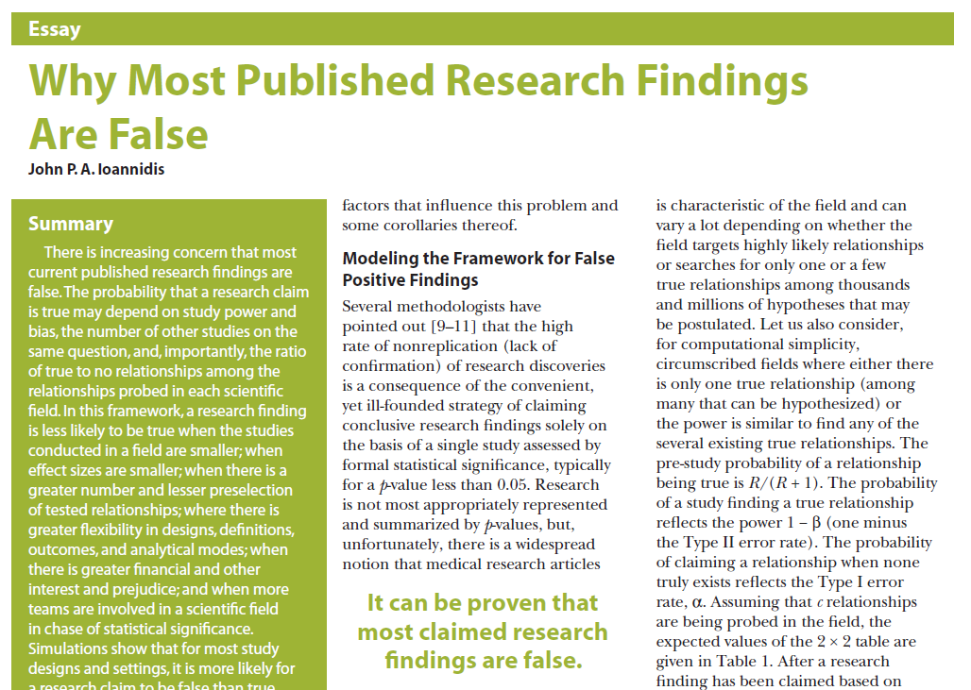
Meta-Analysis
Lab 10
Ioannidis, JPA. 2005. PLoS Medicine
13,000 citations as of 4/2024

Slide 3
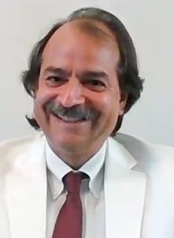
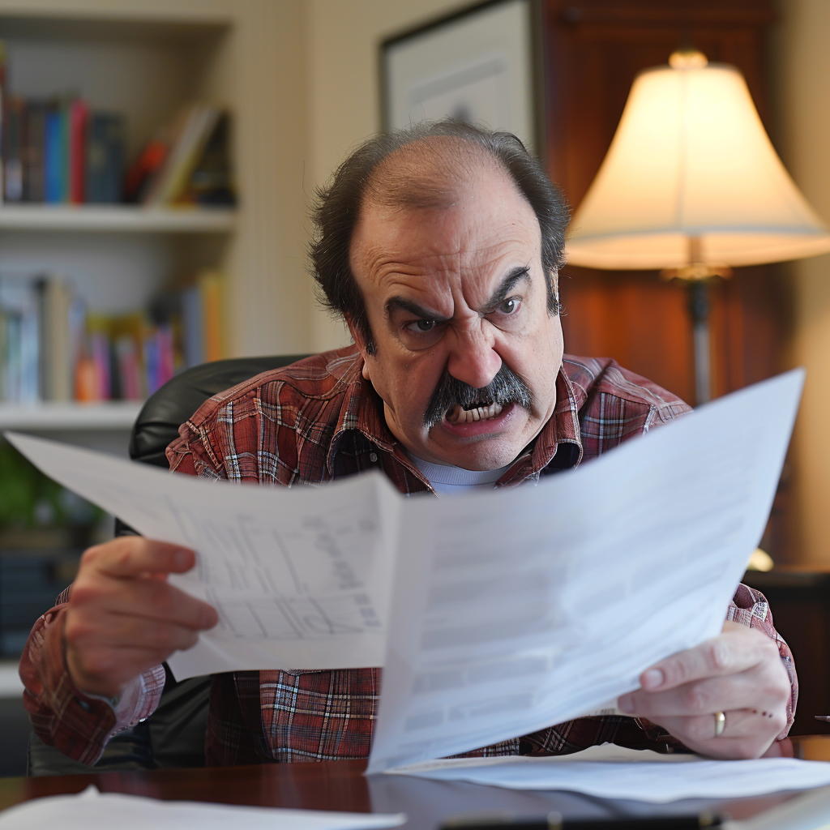
Ioannidis’ complaints
Claims most studies suffer from problems regarding:
Sample size
Size of the effect
Confirmation bias
Flexibility bias
Conflicts of interest
Scientific hotness/popularity
“What matters is the totality of the evidence”
Notes:
Ioannidis argues for high-quality large-scale studies and carefully performed meta-analyses
Left picture is really him; right picture is AI-generated and is too hilarious

Slide 4
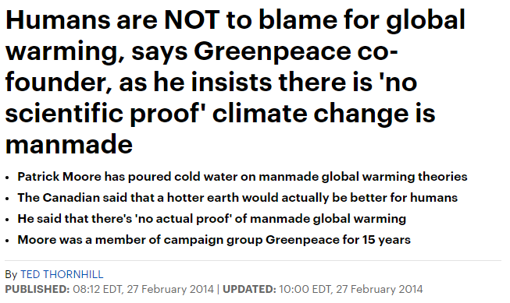
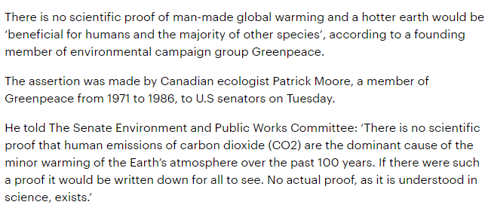
Notes:
https://www.dailymail.co.uk/sciencetech/article-2569215/Humans-not-blame-global-warming-says-Greenpeace-founder-Patrick-Moore.html

Slide 5
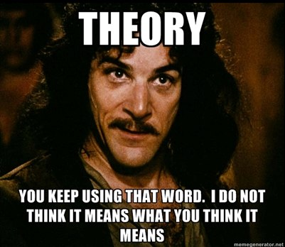
Science is about testing hypotheses, not proving
Proof
Just obliterate this word from your vocabulary
Theory
Supported by many tested hypotheses
Is falsifiable
“Climate change is just a theory”
Hypothesis
A baby theory
Is falsifiable
Evidence supports a hypothesis and rejects an alternative; evidence points in a direction
“Climate change is caused by humans”
Data
Facts, measurements, only become evidence in context of a hypothesis and alternative hypotheses
Something is falsifiable only if it is quantifiable
One of Jacob’s favorite TED talks

Slide 6
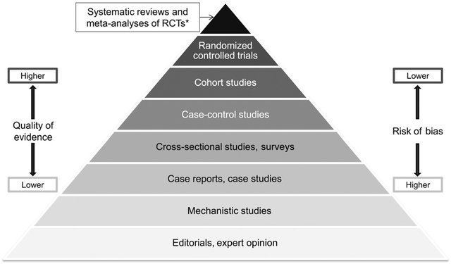
Pyramid of Evidence
Anecdotes, Daily Mail, TikTok videos etc. (hearsay, tabloids, social media)
Notes:
Pyramid is not great because it gives the illusion that these support each other but that’s not necessarily always the case
It’s more representative of abundance – high quality controlled trials are more rare compared to anecdotes, opinions, and garbage info on social media & tabloids

Slide 7
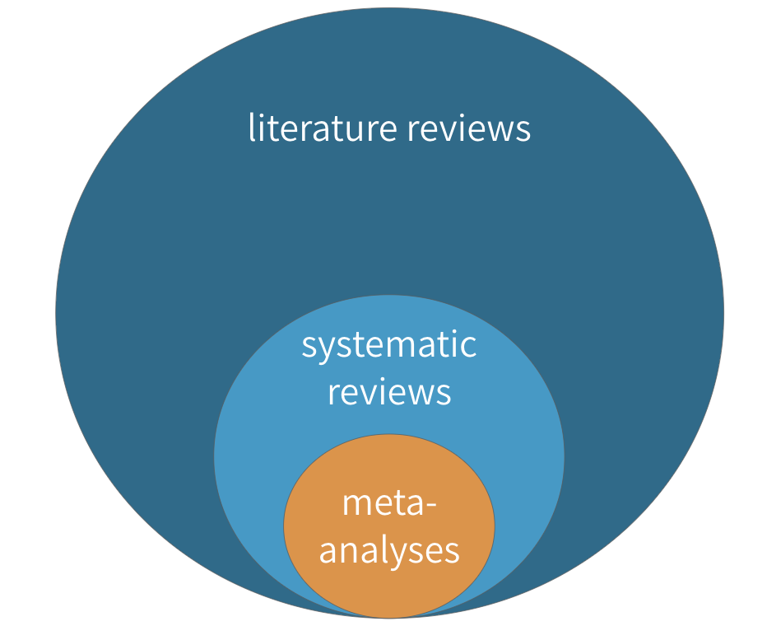
Meta-analysis vs. Systematic reviews
Purpose is to answer specific research question
Meta-analysis is quantitative, statistical analysis of combined results from multiple studies

Slide 8
Inclusion criteria, bias assessment
Literature search is conducted systematically, criteria determined before search
Criteria (See Cochrane Handbook for Systematic Reviews):
Type of studies (e.g. experimental, observational?)
Type of participants (e.g. how is the condition defined?)
Type of intervention (e.g. what are experimental and control conditions?)
Type of outcome (e.g. are outcomes discrete or continuous?)
Bias: ‘Low’, ‘High’, ‘Some concerns’ (See Cochrane Handbook)
Sampling bias, measurement bias, missing data, etc.
None of this is news, but know that there are formal methods

Slide 9
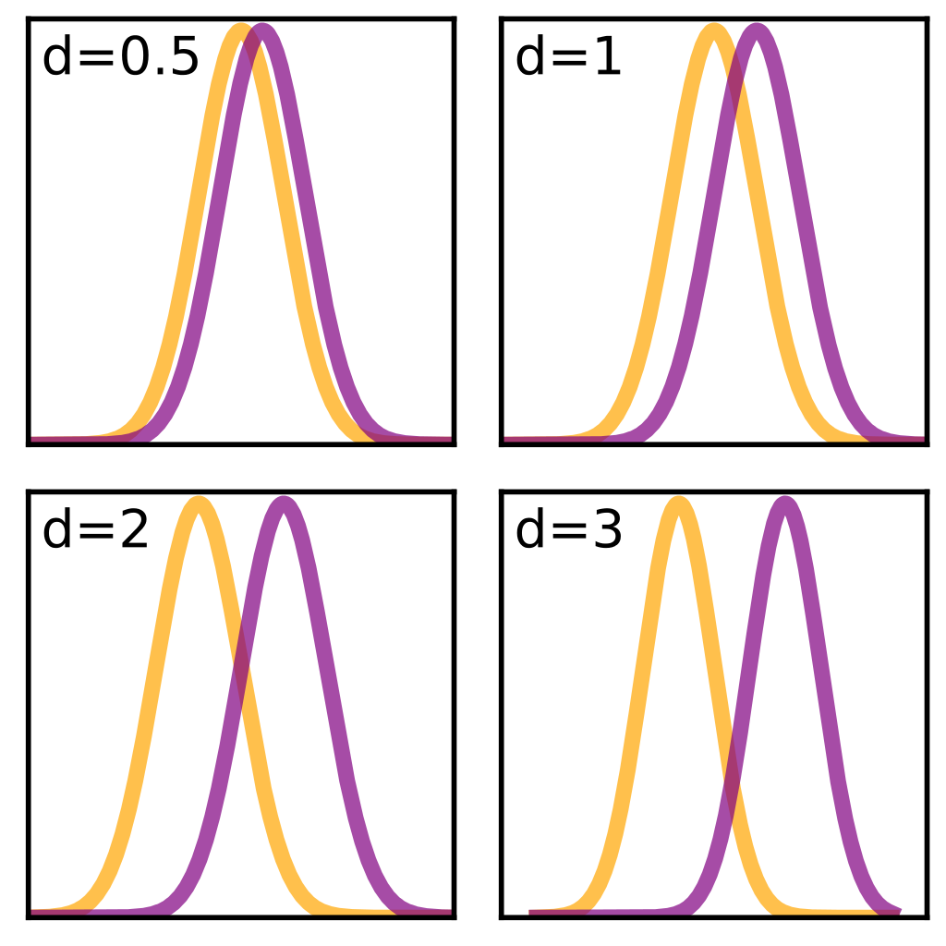
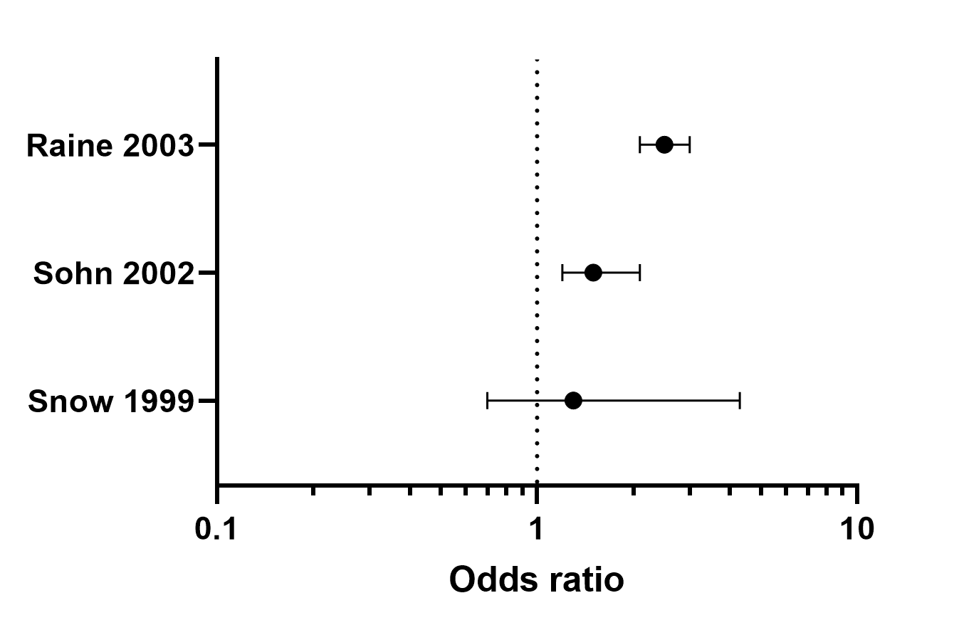
Effect sizes
Correlation family, e.g. Pearson’s r
Difference family, e.g. Cohen’s d
Categorical family, e.g. odds ratios

Slide 10
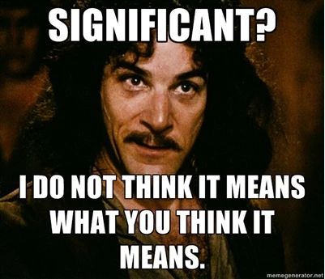
Effect sizes
Why not p-values?
Statistical significance
p-value makes a statistical statement about whether a result of one study is due to sampling
Scales with N
Clinical significance
Effect size captures magnitude of a difference
An effect may be “statistically significant” but meaningless in real life
high N
low p
d = 0.12
low N
high p
d = 0.12

Slide 11
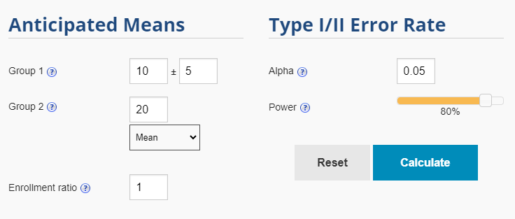
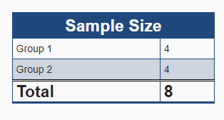
Power
How much N do you need, IF an effect exists?
Need some preliminary data to compute (means and variance)
“One limitation is the small sample size” translates “This study is under-powered”

Slide 12
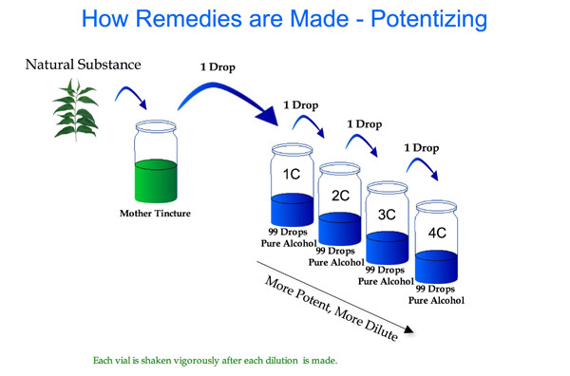
Homeopathy

Slide 13
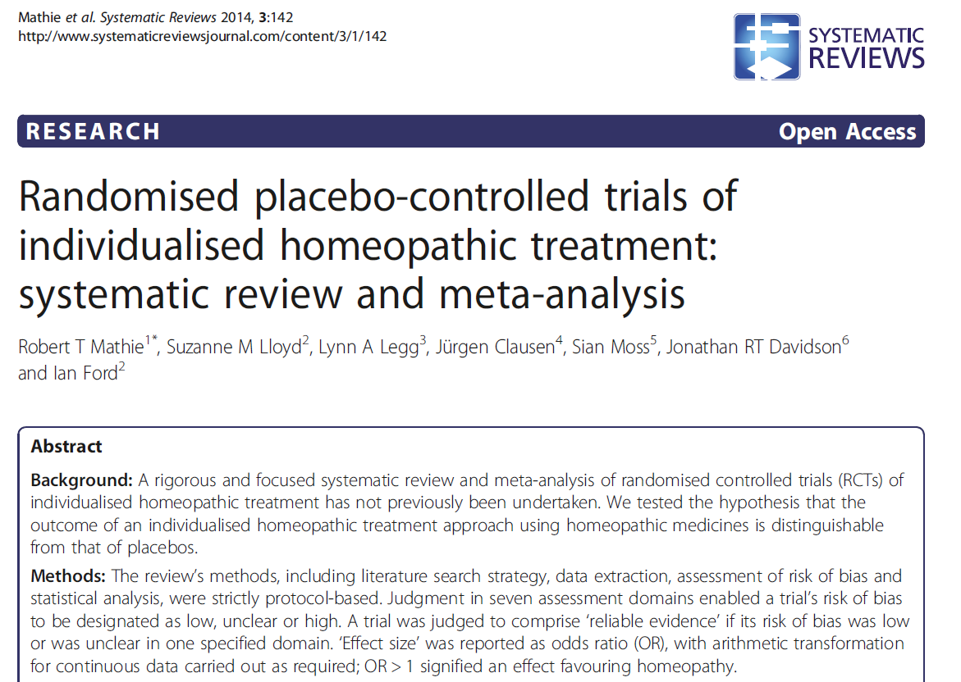

Slide 14
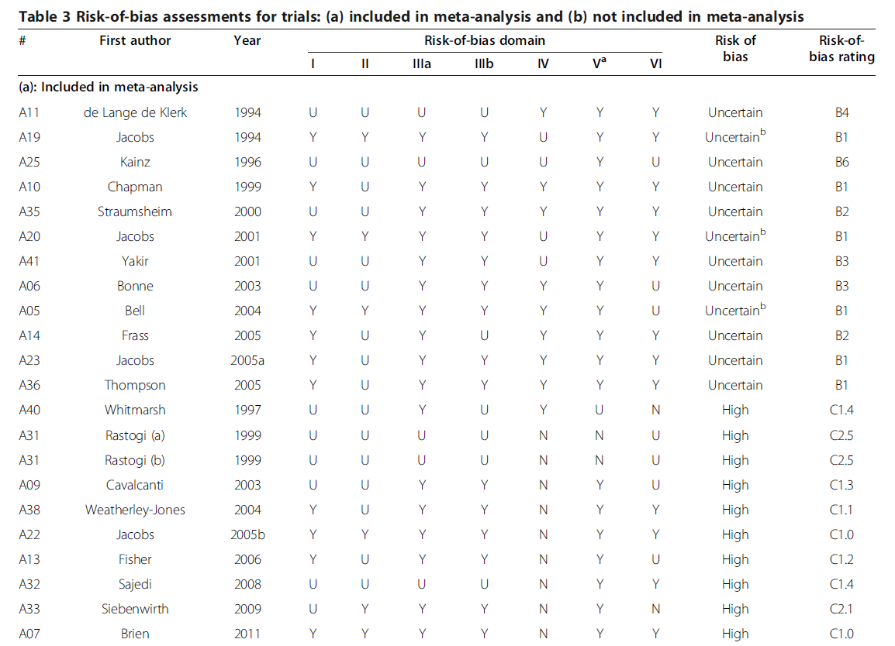
Notes:
These are all the studies included – how many had low risk of bias?

Slide 15
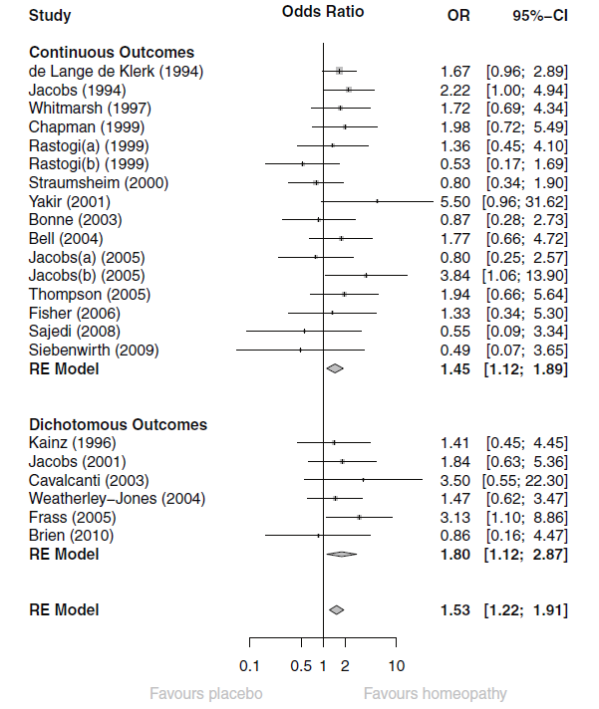
Forest plot
Notes:
Forest plot

Slide 16
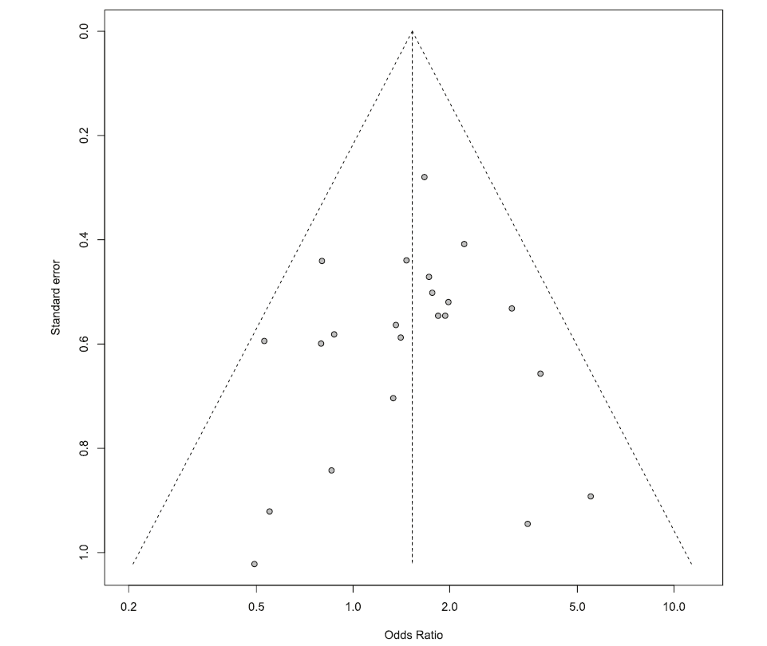
Funnel plot
Notes:
Funnel plot

Slide 17
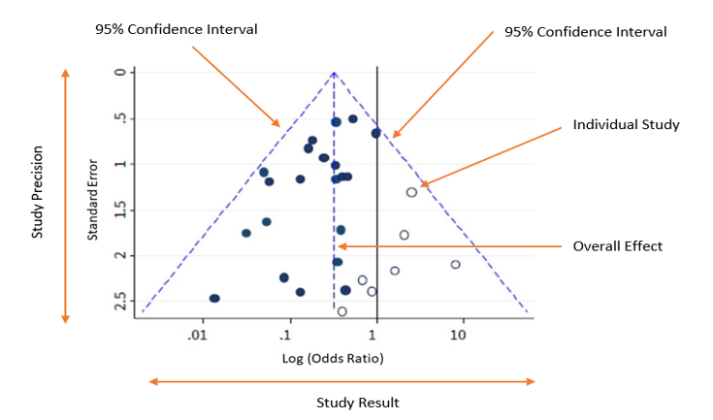
Notes:
Funnel plot

Slide 18
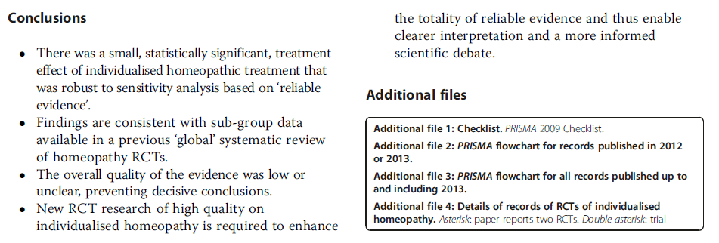
Notes:
Are the authors selling a positive conclusion – that homeopathy works?
Do you agree that more research is needed to have an informed scientific debate?

Slide 19

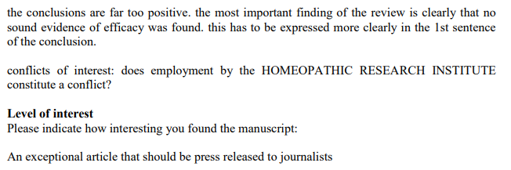
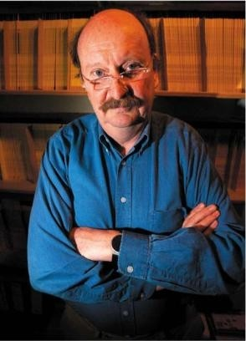
How did this get published?
You can read the authors’ responses here
Edzard Ernst, modern hero
Notes:
Reviewed by Edzard Ernst who is a highly vocal critic of “alternative” medicine; my guess is he thought the authors/journals would be making fools of themselves by drawing attention to this study

Slide 20
Evidence-based vs. Science-based thinking
Are all research questions valid?
Remember Bayes:
Evidence-based thinking weighs likelihood of a hypothesis given data
Science-based thinking adds prior plausibility of a hypothesis
Power: What’s the likelihood Homeopathy works?
Science-based: What’s the likelihood Homeopathy works, given we know it’s bullshit?
Science-Based Medicine blog
Jacob’s favorite podcast: Skeptic’s Guide to the Universe

Slide 21
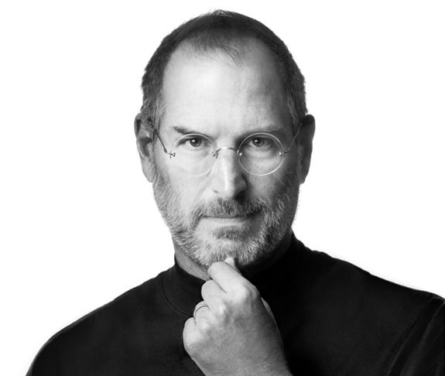
Critical thinking – the stakes are high
Steve Jobs changed the world with tech
Diagnosed with pancreatic cancer in 2003
Sought “alternative treatment” for 9 months
Aggressive vegan diet, acupuncture, psychics
Died from pancreatic tumor complications in 2011
The world lost a great mind; pseudoscience didn’t help
More reading
Notes:
This is not a criticism of decisions – Jobs was a smart dude dealing with the best information he could find
Cancer, surgery, chemotherapy are serious and scary decisions
In hindsight, it’s easier to see that Jobs should have approached his cancer more aggressively with legit medical treatment

Slide 22

Lab Wrap-up
4 things you need to rock the world as a data scientist:
Data
Code
Critical thinking
Communicating with others
Jacob’s opinionated list of super-powers:
Thinking slowly
Debugging
--------------------------------------------------------------------------------
Regular Expressions
Logical Indexing
Visualization
Notes:
These are the take-aways I promised you early in the semester. I hope I delivered on them. If not, please leave me some feedback!!
I got this image with Midjourney with the prompt “watercolor painting of regular expressions”
I liked that it came up with this human face that is colored and constructed with written text

Slide 23

Thank you for being awesome students & humans
Notes:
Another Midjourney image, and I like that it’s a hopeful image.
There is a wall of data and code on the right, you are in the center, and emanating from your guitar (your instrument, your laptop) is a ray of enlightenment!

